Slide 1
Event-based Asynchronous Sparse Convolutional Networks
Nico Messikommer, Daniel Gehrig, Antonio Loquercio, and Davide Scaramuzza
(2020)

Slide 2
Overall algorithm
Submanifold Sparse Convolutions (Spatial):
convolution output is restricted to "Active Sites" (non-zero pixels) in the input, preventing the data from thickening or "dilating" into empty space
Recursive Delta Propagation (Temporal):
when an event occurs, the algorithm calculates the change Δ and propagates it only through the specific chain of neurons connected to that pixel

Slide 3
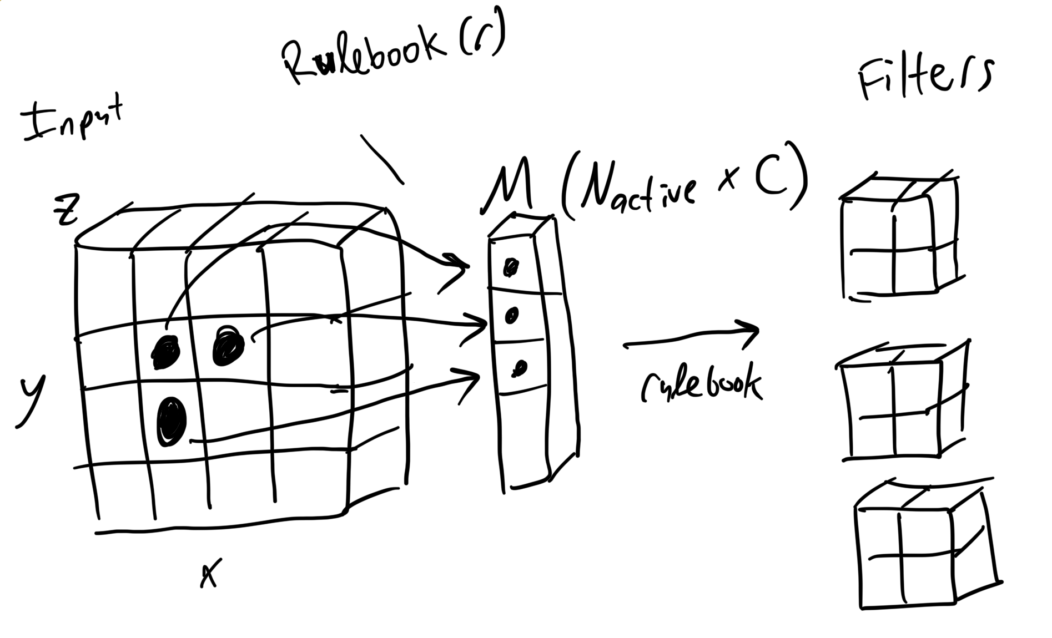
Submanifold sparse convolution

Slide 4
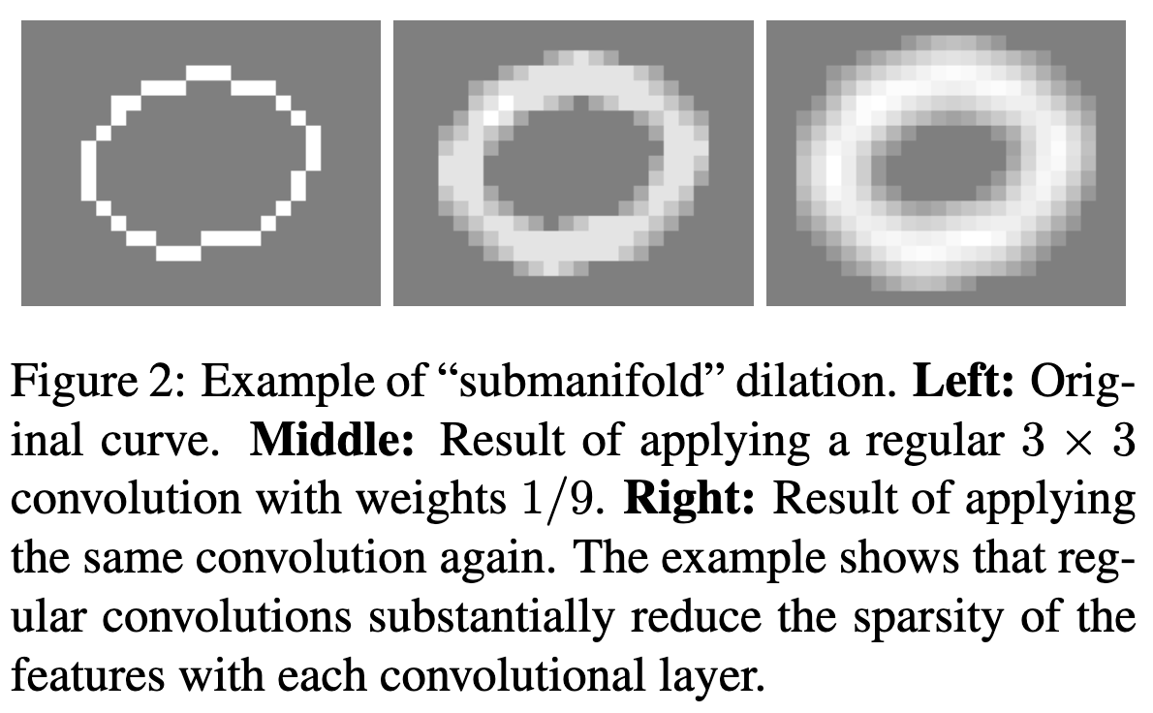
Submanifold trick
Using a standard convolution, in which the entire filter is activated if a single pixel is active, results in dilation as more convolutions are applied. This is unacceptable for deep networks.
“3D Semantic Segmentation with Submanifold Sparse Convolutional Networks” (Graham, 2017)

Slide 5
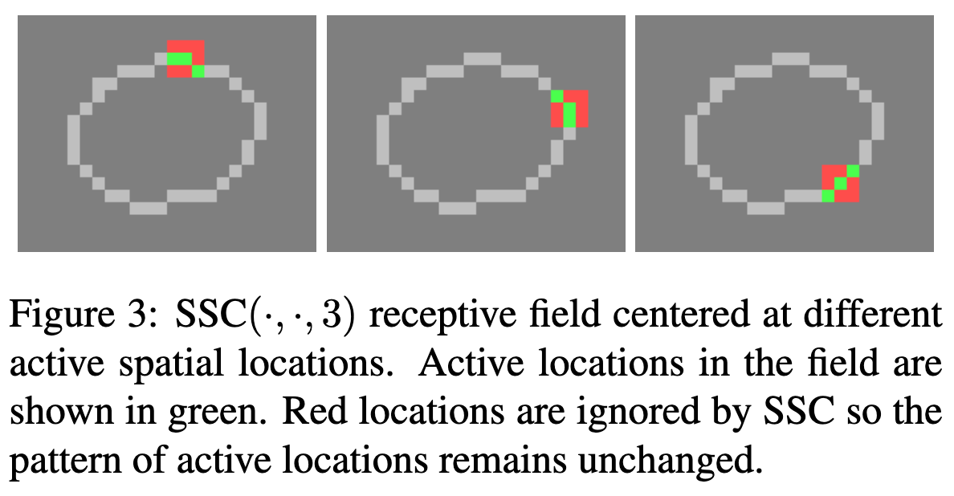
Submanifold trick
By limiting the convolution to only pixels that are active, we maintain sparsity after each operation.
“3D Semantic Segmentation with Submanifold Sparse Convolutional Networks” (Graham, 2017)

Slide 6
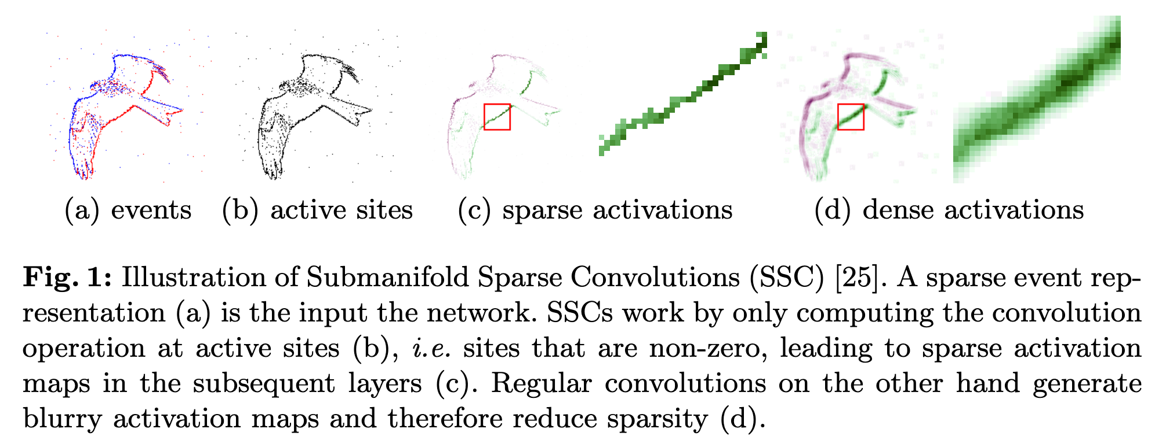
Submanifold trick
The same idea illustrated in the current paper.
“Event-based Asynchronous Sparse Convolutional Networks” (Graham, 2020)

Slide 7
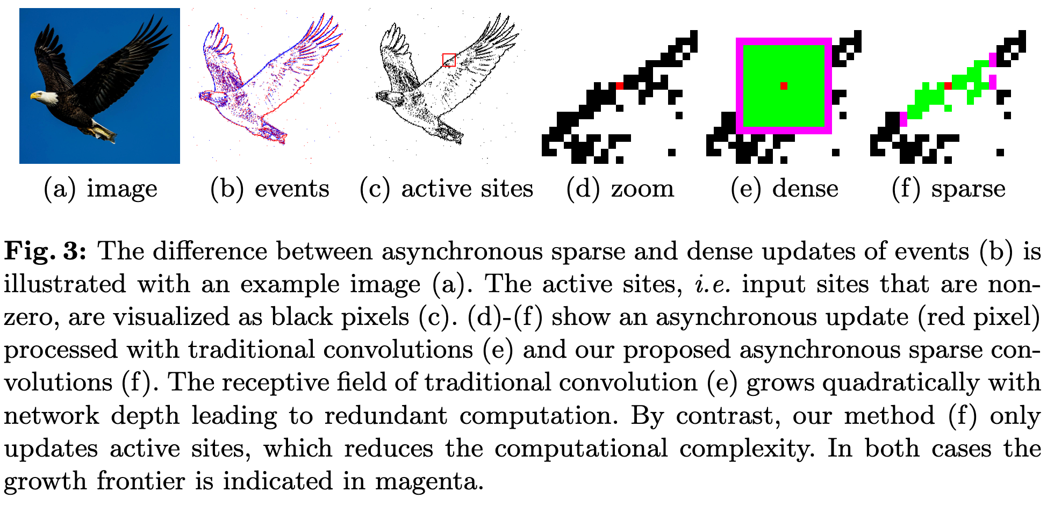
More on the submanifold trick
By only convolving over the active sites, the network maintains sparseness through the layers.

Slide 8
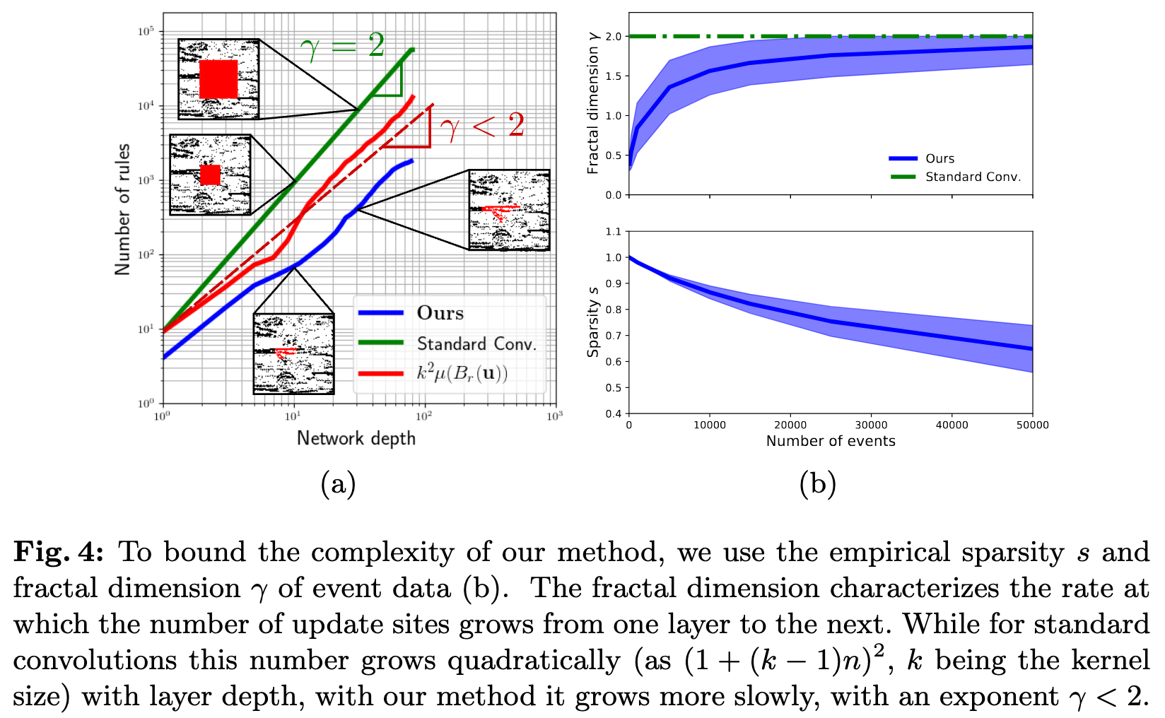
Algorithm complexity
This method is guaranteed to grow with a fractal dimension < 2, reducing complexity especially as the number of layers in the network increase.

Slide 9
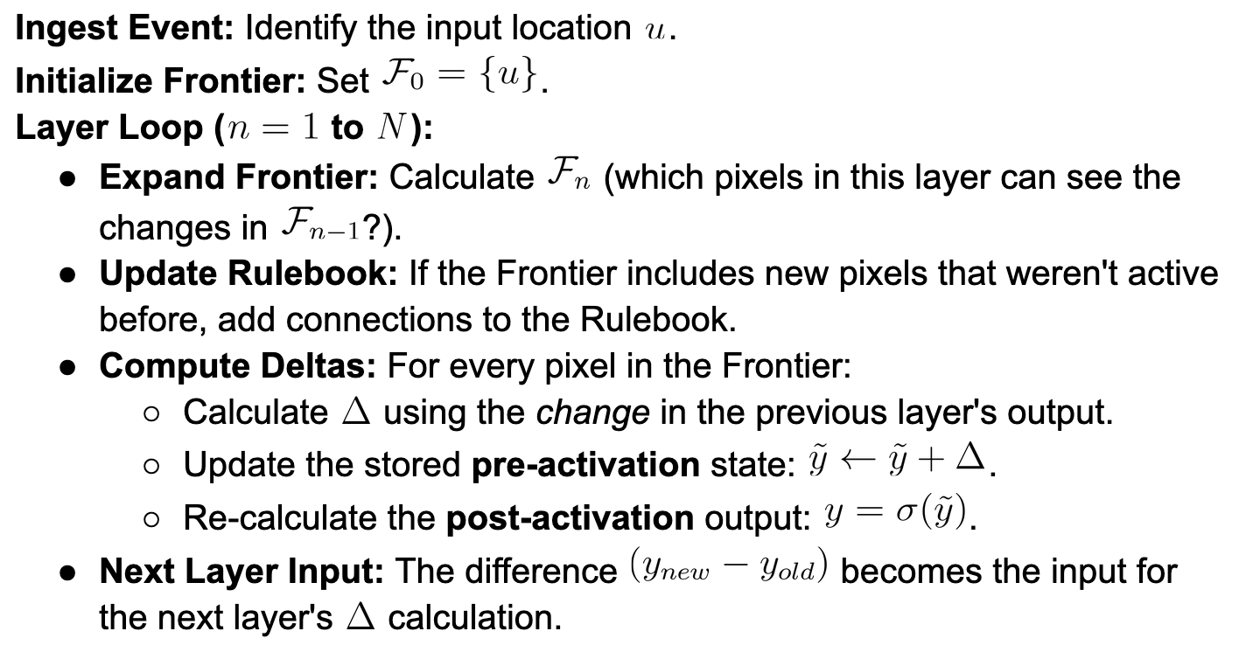
Recursive delta propagation

Slide 10
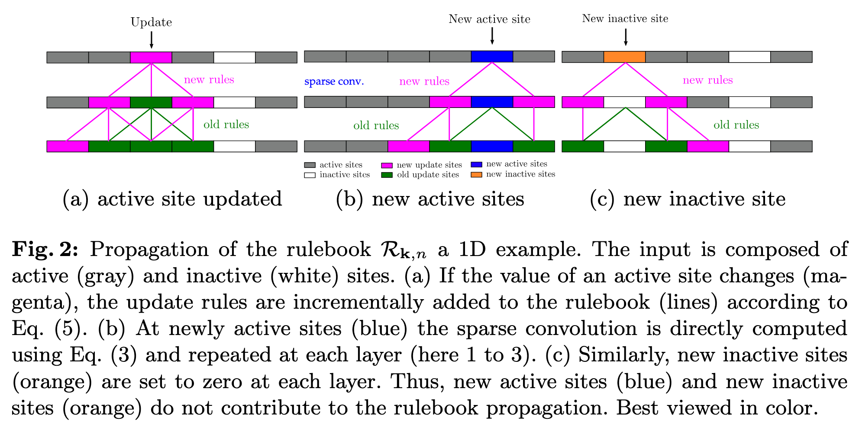
Rulebook updating approach
Only update active sites and their connections within the network in the rulebook when a change occurs at an site (becomes active or inactive). The rulebook acts as a sparse wiring diagram for the network.

Slide 11
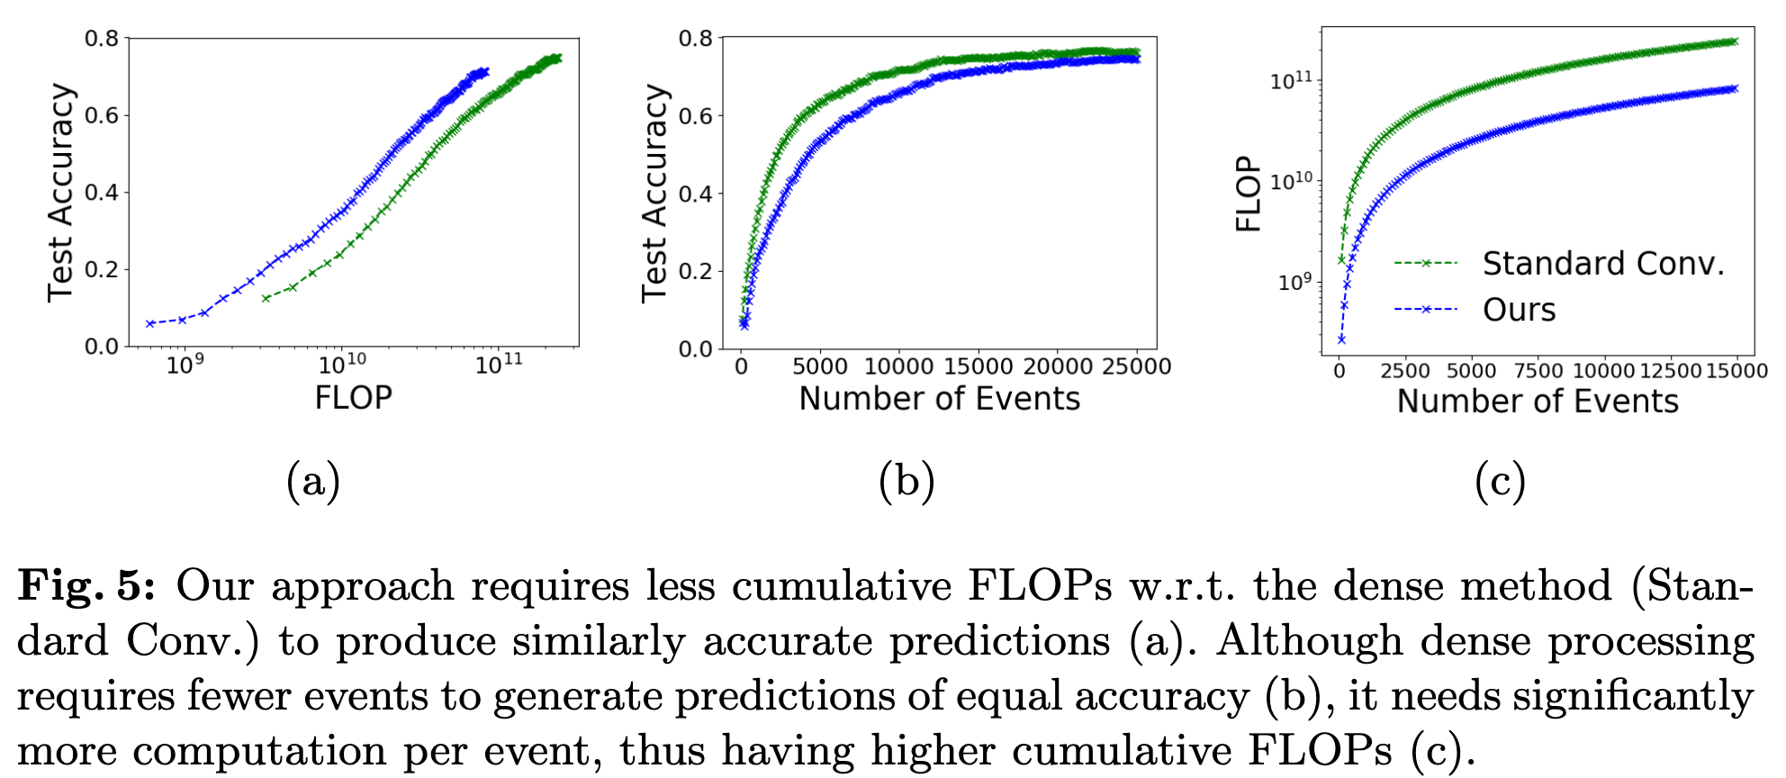
Results
Approach is more efficient

Slide 12
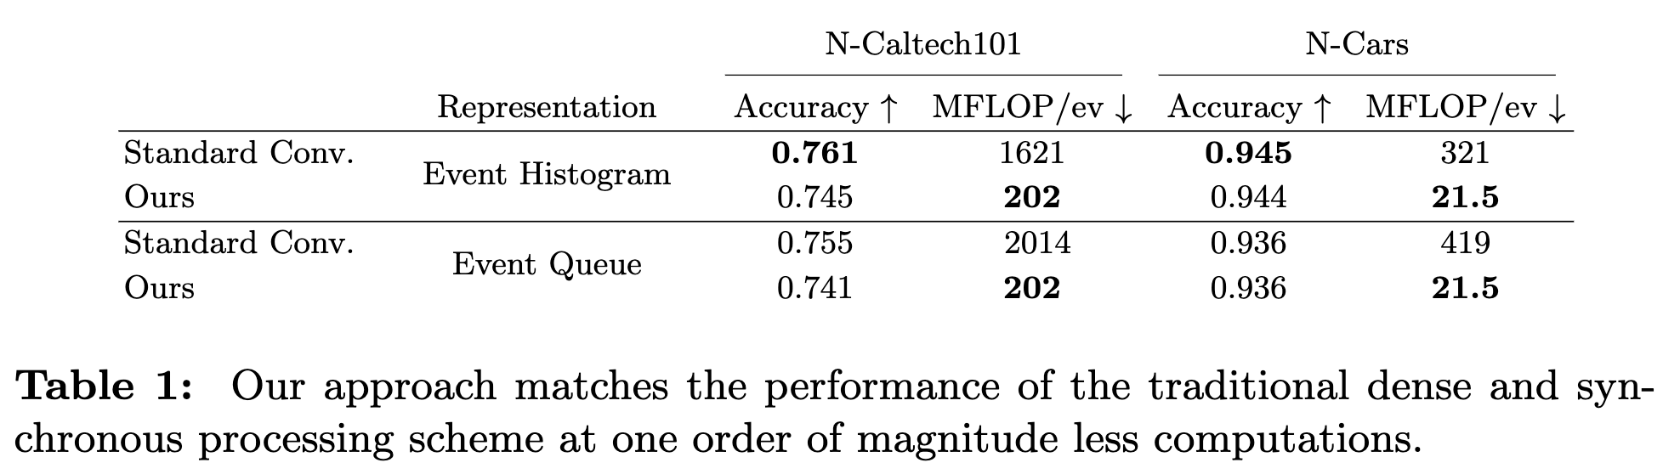
Results
Matches performance of event histogram and event queue.

Slide 13
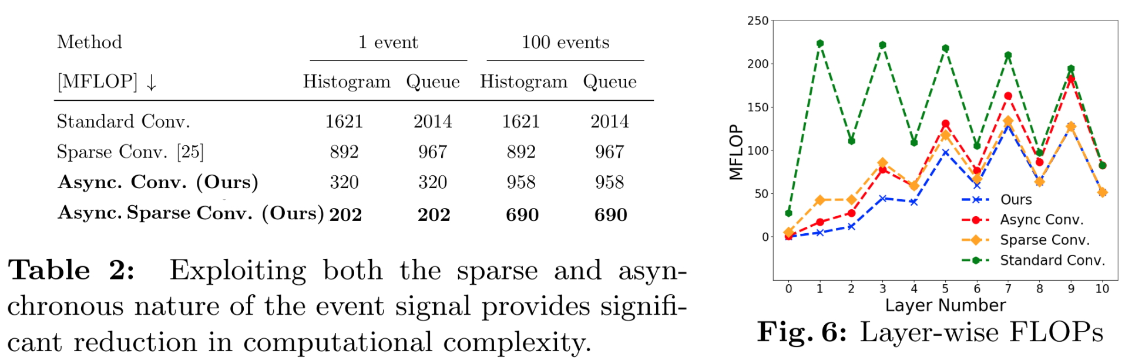
Results
Exploiting sparsity improves efficiency when there are fewer events compared to other approaches which require the same MFLOPs regardless of the number of events.
Notes:
Event queue maintains a queue for each pixel location that tracks a certain number of events, with their timestamps and polarities. (e.g. ror a queue length of 15, this results in a 3D tensor with 30 channels (15 timestamps + 15 polarities) at each spatial location).

Slide 14
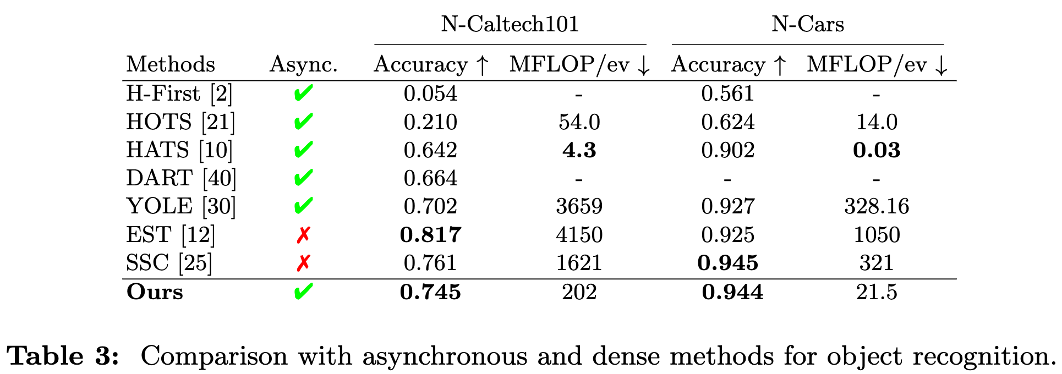
Results
Similar performance for object recognition compared to other approaches.

Slide 15
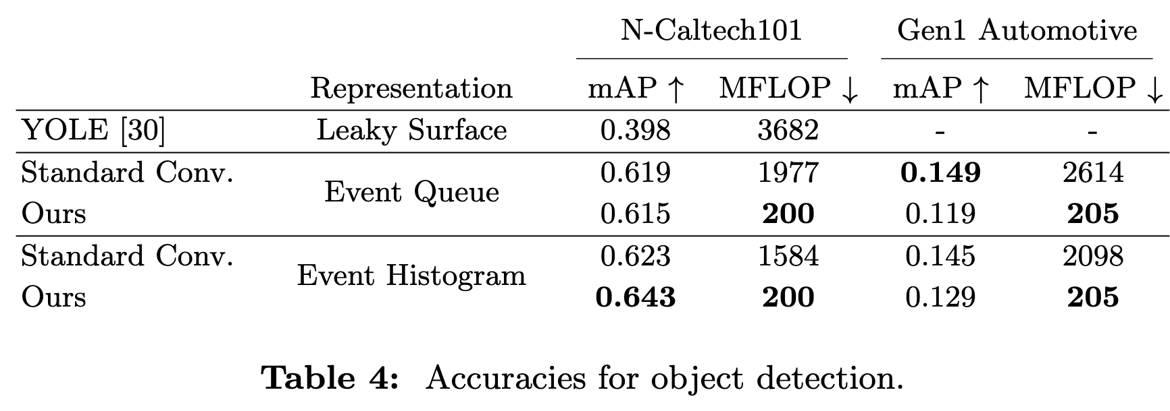
Results
Similar performance for object recognition compared to other approaches, while being more efficient.

Slide 16
References
Messikommer, N., Gehrig, D., Loquercio, A. & Scaramuzza, D. Event-based Asynchronous Sparse Convolutional Networks. arXiv (2020) doi:10.48550/arxiv.2003.09148.
Graham, B., Engelcke, M. & Maaten, L. van der. 3D Semantic Segmentation with Submanifold Sparse Convolutional Networks. 2018 IEEECVF Conf. Comput. Vis. Pattern Recognit. 9224–9232 (2018) doi:10.1109/cvpr.2018.00961.
Graham, B. Sparse 3D convolutional neural networks. Procedings Br. Mach. Vis. Conf. 2015 150.1-150.9 (2015) doi:10.5244/c.29.150.

